Slide 1


Day 5 Lecture 1: What do we now about SARS-CoV-2
Short course on modelling infectious disease dynamics in R
Ankara, Türkiye, June 2023
Dr Juan F Vesga

Slide 2
Aims of the session
Briefly review the evidence for the main epidemiological parameters on SARS-CoV-2
Understand what are the minimum requirements for designing a model for COVID-19
Understand the challenges forward for the rest of the pandemic

Slide 3
SARS-CoV2 : the start of a pandemic
In Dec 2019 China CDC announces an outbreak investigation for a new respiratory syndrome in Wuhan
Cases linked to a food market
Human to human transmission becomes evident
A coronavirus is identified as the culprit
First restrictions imposed Wuhan in mid-Jan 2020
Li et al NEJM 2020

Slide 4
SARS-CoV2 : the start of a pandemic
Li et al NEJM 2020

Slide 5
Transmission of SARS-CoV2
Zoonotic origin has been suggested and linked to a seafood market, but investigation is ongoing
This was followed by evident human to human transmission
Previous evidence of SARS and other coronaviruses indicated that aerosols, droplets and direct contact with infectious people is the main route of transmission
Li et al NEJM 2020

Slide 6
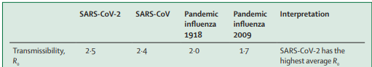
Transmissibility of SARS-CoV2
SARS-CoV2 appears highly transmissible and initial estimations of R0 suggest a R0 of 2.2 ; range [1.4 – 3.9 ]
Higher end of the range is highly discussed and depends on specific settings
Comparison with other pandemics puts COVID-19 at the upper end
Li et al NEJM 2020
Petersen K et al Lancet 2020

Slide 7
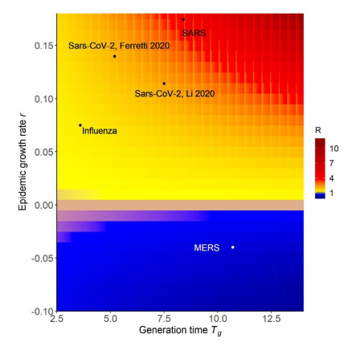
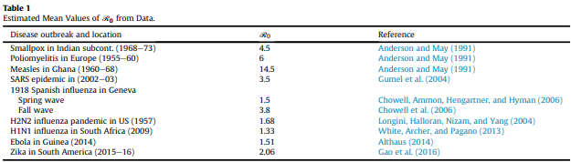
Transmissibility of SARS-CoV2
van den Driessche IDM 2017
The Royal Society at https://royalsociety.org/-/media/policy/projects/set-c/set-covid-19-R-estimates.pdf

Slide 8
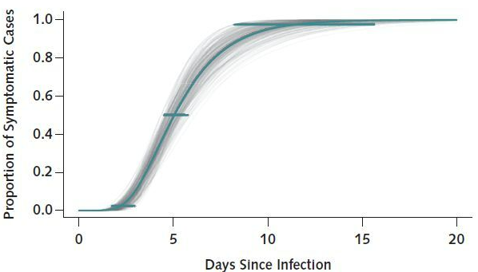
Course of disease
Infection is followed by a non-infectious period of “incubation”
Driven by a baseline transmissibility of ~2.2
S
E
An incubation period ~5.1 days
Lauer et al Ann Intern Med 2020

Slide 9
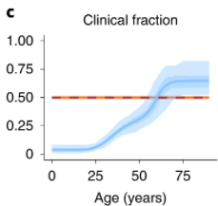
Course of disease
Those exposed become symptomatic after ~5.1 days
A fraction will not develop symptoms. This can ~ 79% in 10-19 yr old , and 31% in > 20yr old
~50% (in all ages) are asymptomatic
Driven by a baseline transmissibility of ~2.2
I_{a}
S
E
I_{s}
An incubation period ~5.1 days
Davies et al Nature medicine 2020

Slide 10
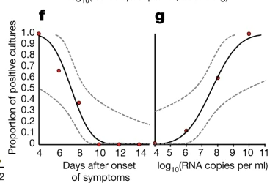
Course of disease
Evidence says that virus shedding can be around 3 days, and in some cases as long as 15
~50% (in all ages) are asymptomatic
Driven by a baseline transmissibility of ~2.2
infectiousness can be ~3 days
I_{a}
S
E
R
I_{s}
An incubation period ~5.1 days
Wölfel R et al Nature 2020
Liu W-D et al Journal of Infection 2020

Slide 11
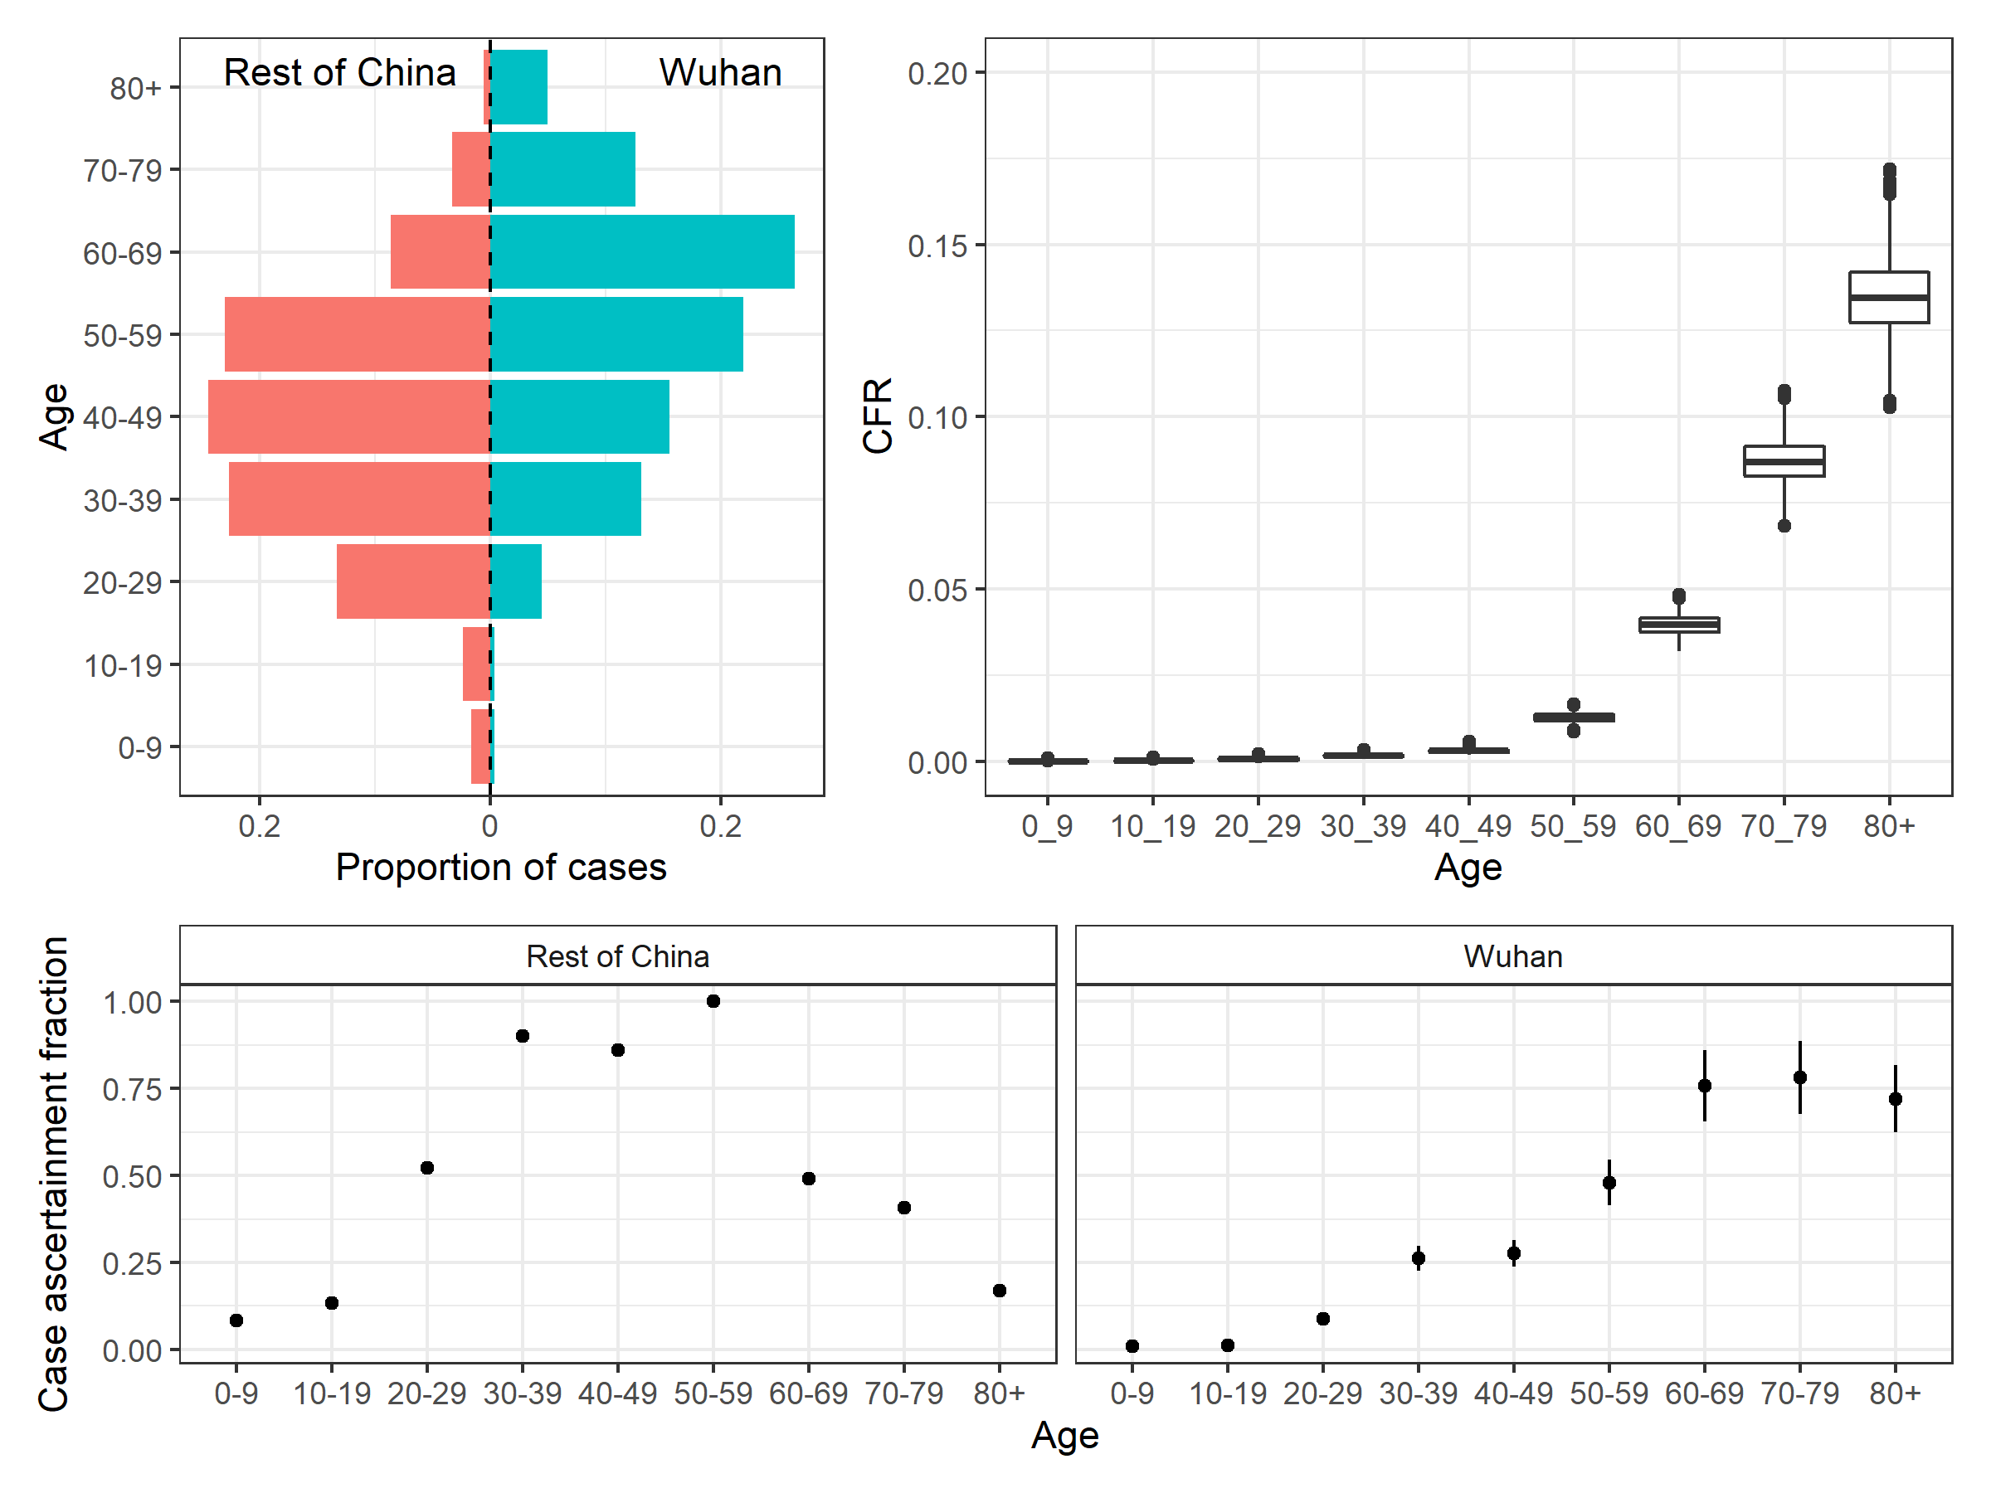
Course of disease
From China (February 2020):
Case fatality ratio 1.4%
Infection fatality ratio 0.7%
Steep rise from age 50 upwards
Case fatality ratios for other respiratory diseases
SARS ~10%
H1N1 flu (2009) ~0.01%
Spanish flu (1918) ~ 2%
UK, EU and US data giving similar estimates – UK saw 0.8-1.2% IFR
~50% (in all ages) are asymptomatic
Driven by a baseline transmissibility of ~2.2
infectiousness can be ~3 days
I_{a}
S
E
R
I_{s}
An incubation period ~5.1 days
CFR ~ 1.4%
Verity et al Lancet ID 2020

Slide 12
We have a model!
A simple SEIR model can be used to digest the core epidemiology of SARS-CoV2
Every parameter is subject to further interpretation and added complexity
The main mechanics of infection control can roughly be simulated with this initial approach
~50% (in all ages) are asymptomatic
Driven by a baseline transmissibility of ~2.2
infectiousness can be ~3 days
I_{a}
S
E
R
I_{s}
An incubation period ~5.1 days
CFR ~ 1.4%

Slide 13
What can we say so far ?
Highly infectious: R₀~2.5-4, doubling time 2-5 days without controls
Lethality high (~1% of those infected)
Age plays a central role in defining severity
Understanding infectivity did not stop in Jan 2020! New variants can change the game

Slide 14
Challenges
Is not only about CFR, healthcare demand higher (2-3% require hospitalisation)
Without control measures, health systems can be overwhelmed anywhere, increasing mortality further
But only available control measures are either economically costly or difficult to scale
Four strategies:
Mitigation – managing but not stopping the epidemic
Suppression – stopping (or delaying) the epidemic
Vaccination
Improved medical care

Slide 15
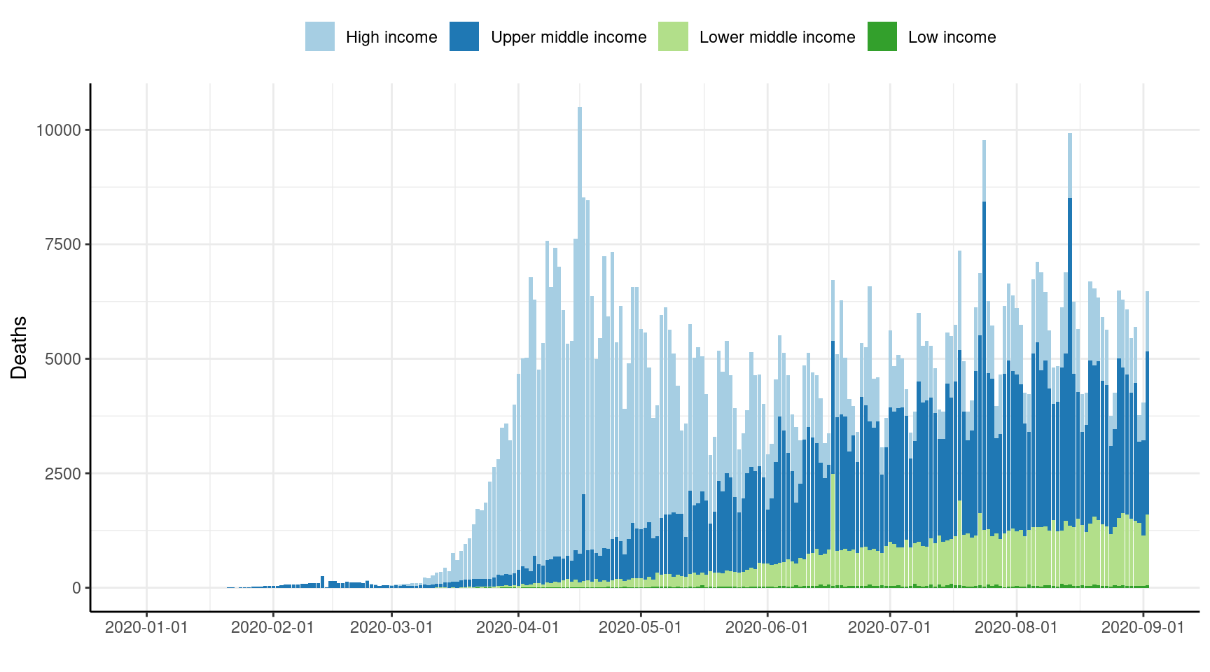
Mitigation
LMICs implemented earlier in their epidemics than higher-income countries – so more effectively prevented early exponential growth
Suppression less easy to sustain
Europe, North America, Latin America, Middle East and South Asia all experiencing epidemics
Africa appears less affected to date – with exceptions (e.g. South Africa)
Walker et al Science 2020

Slide 16
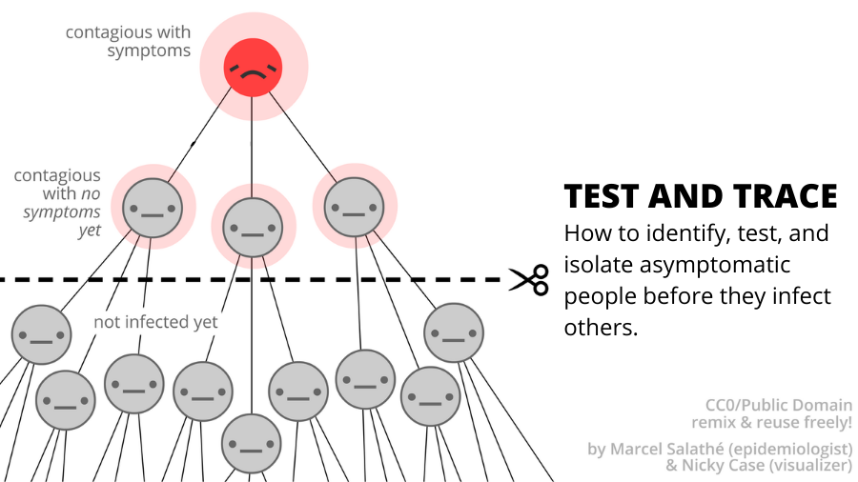
Suppression (pre-vaccination)
Mostly worked as intended, but hugely costly and therefore unsustainable
But just lifting measures risks all the gains made
Relaxation will inevitably push us into R>1 eventually
Only alternative to episodic lockdown is controlling individual local chains of transmission
Test and trace
Early cluster detection
Local lockdowns

Slide 17
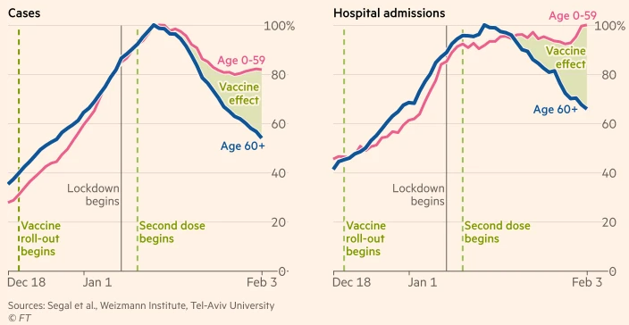
Vaccination
Unprecedented scale up of immunization programmes globally
Effect observed almost immediately
Protection from hospitalization has been observed to be ~60% for most vaccines
Most vaccines protect against mortality >99%
Financial Times Feb 2021

Slide 18
Improved medical care
It is thought that improved in ICU medical care for SARS-CoV2 together with new algorithms of care has reduced mortality
New formulations of antivirals (Remdesivir) can improve outcomes of severe disease

Slide 19
Summary
From the day of epidemic start, we have gathered useful metrics to understand epidemiology of COV1D-19
The SEIR model fits the case, with some slight modifications
More complexity should be added to accurately reproduce transmission
SARS-CoV2 is highly infectious compared with previous pandemics
A high lethality and severity makes it even more challenging

